Slide 1
Recurrence Relation
by
Dr. T. M. Rajalaxmi
Assistant Professor
Department of Mathematics

Slide 2
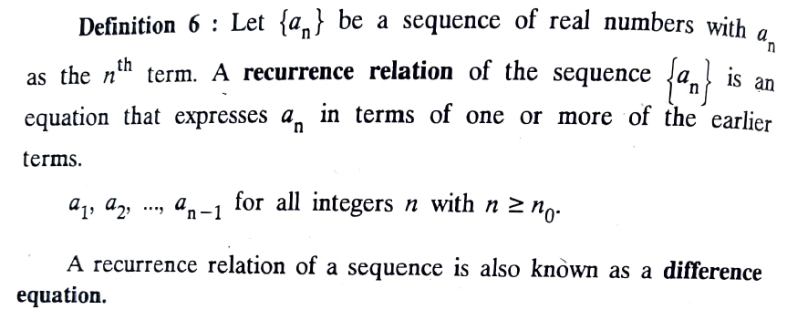

Definition

Slide 3
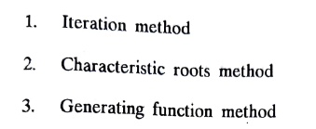
Solution of Recurrence Relation

Slide 4
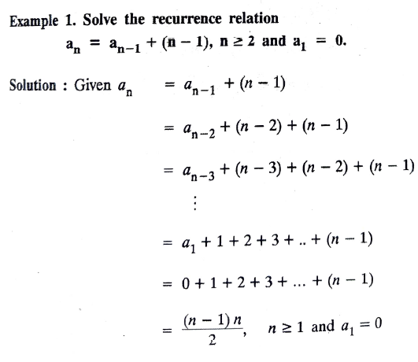
Iteration Method

Slide 5
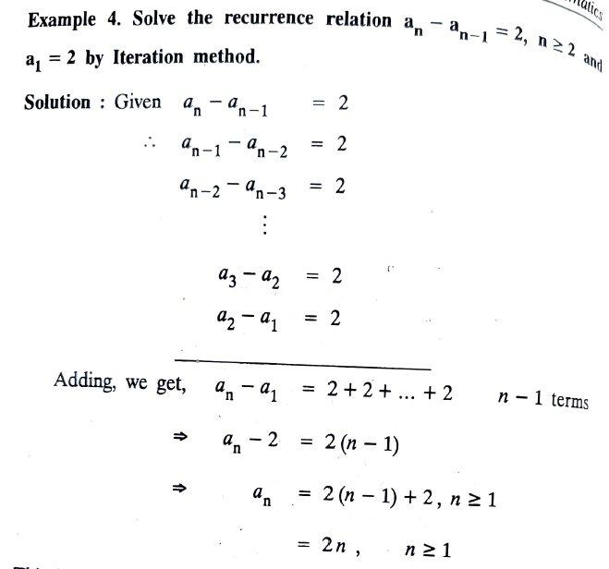
Iteration Method

Slide 6
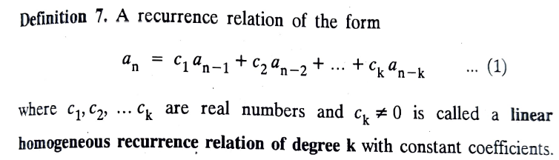
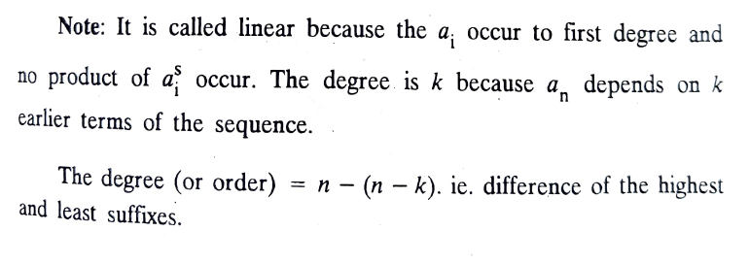
Linear Homogeneous Recurrence Relation

Slide 7
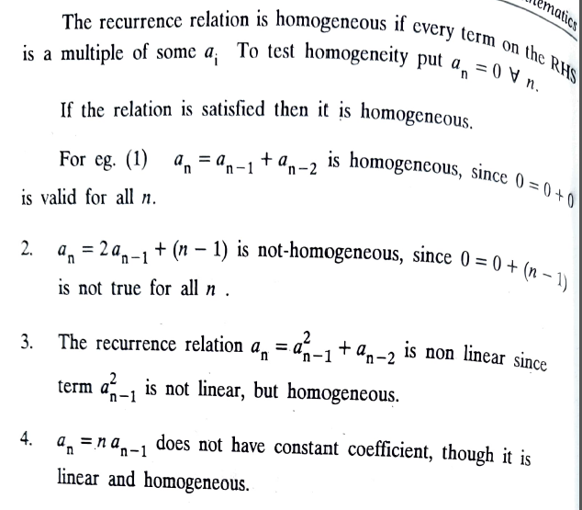
Linear Homogeneous Recurrence Relation

Slide 8
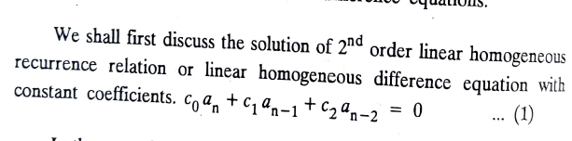
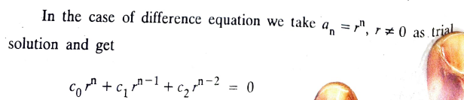
Characteristic Root Method

Slide 9
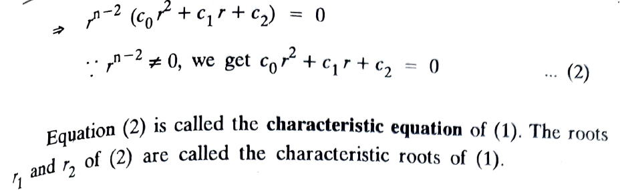
Characteristic Root Method

Slide 10
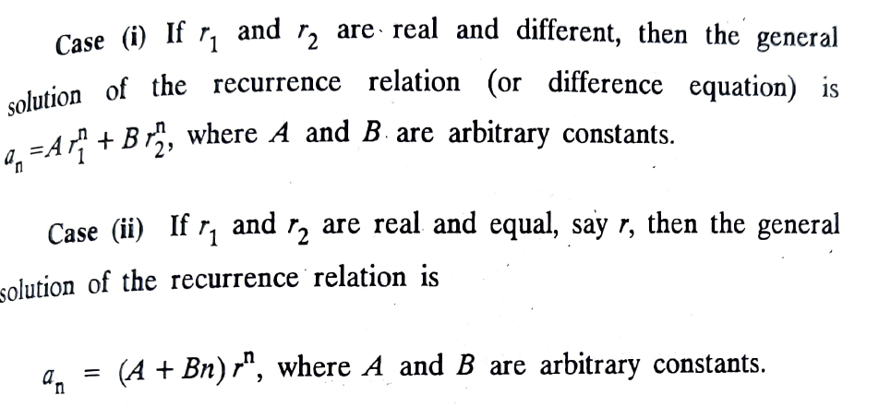
Characteristic Root Method

Slide 11
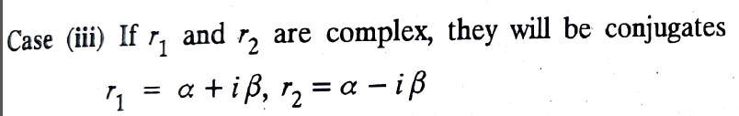
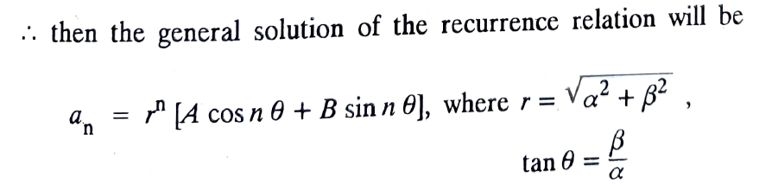
Characteristic Root Method

Slide 12
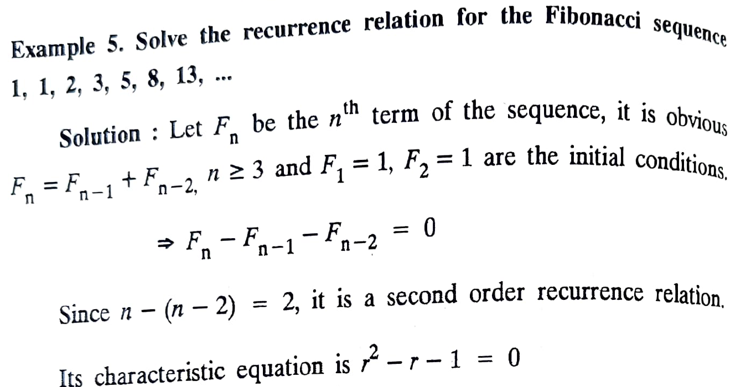
Problems – Characteristic Root Method

Slide 13
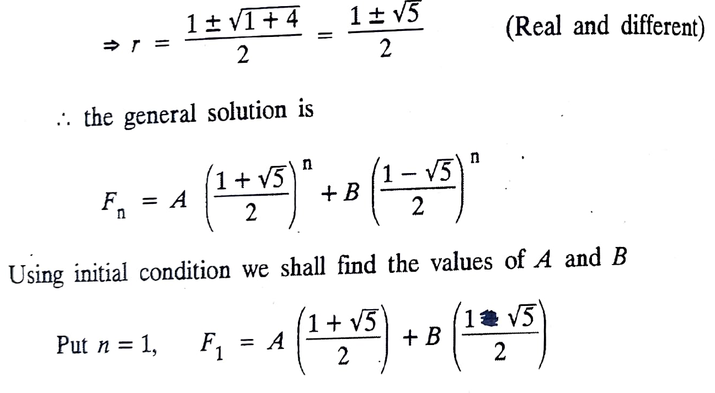
Problems – Characteristic Root Method

Slide 14
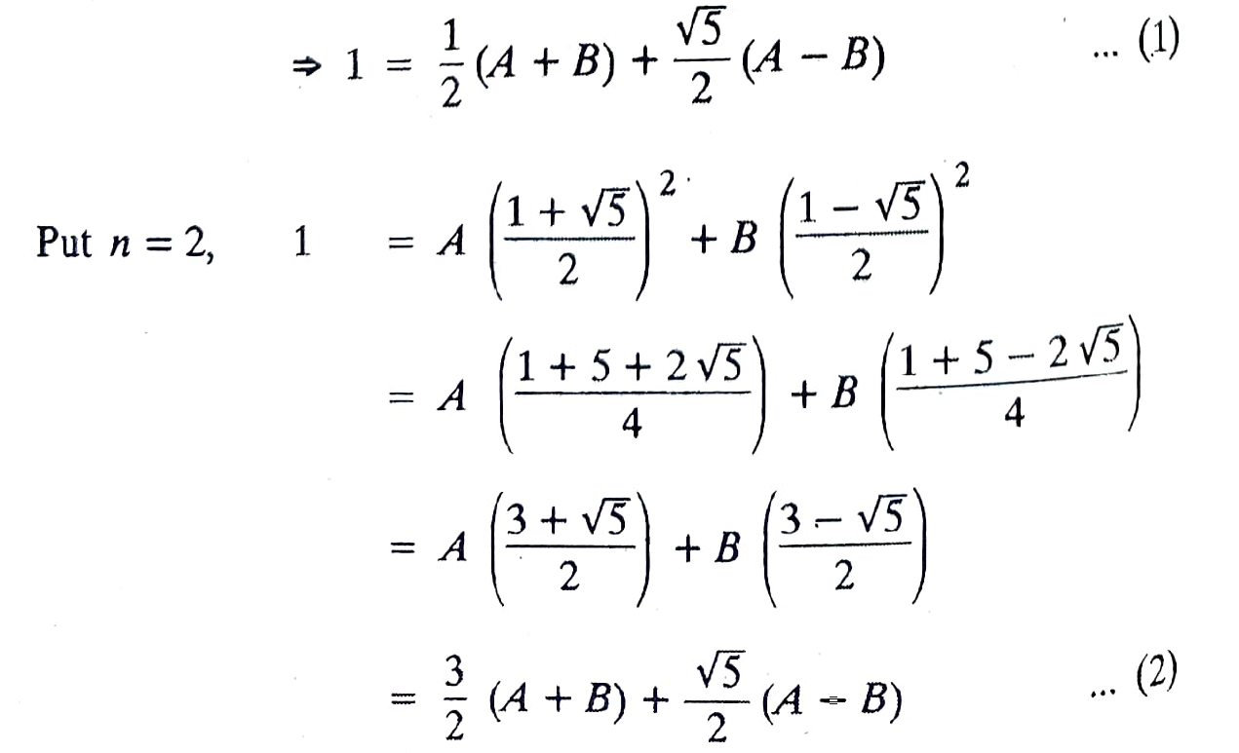
Problems – Characteristic Root Method

Slide 15
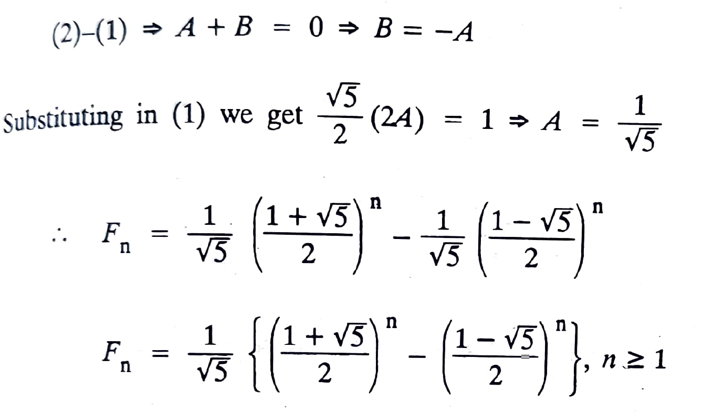
Problems – Characteristic Root Method

Slide 16
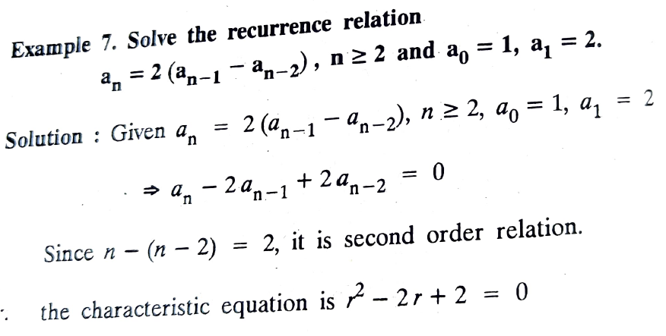
Problems – Characteristic Root Method

Slide 17
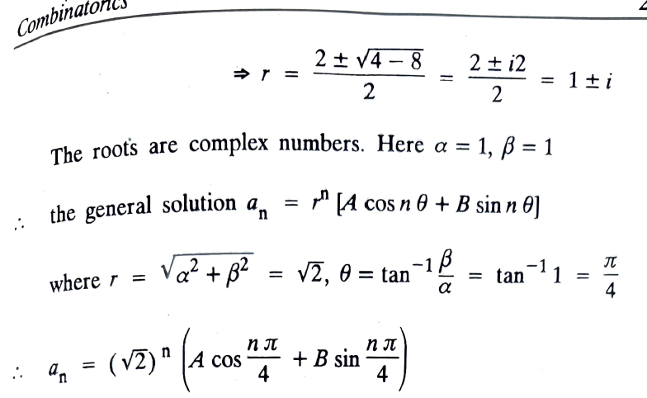
Problems – Characteristic Root Method

Slide 18
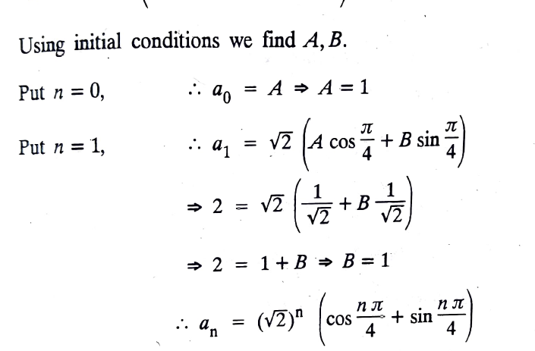
Problems – Characteristic Root Method

Slide 19
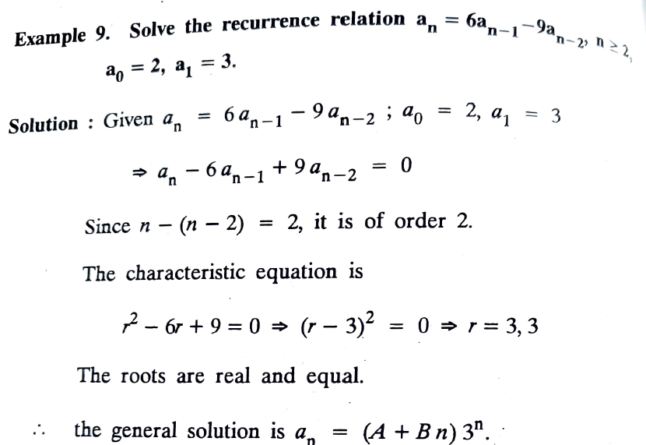
Problems – Characteristic Root Method

Slide 20
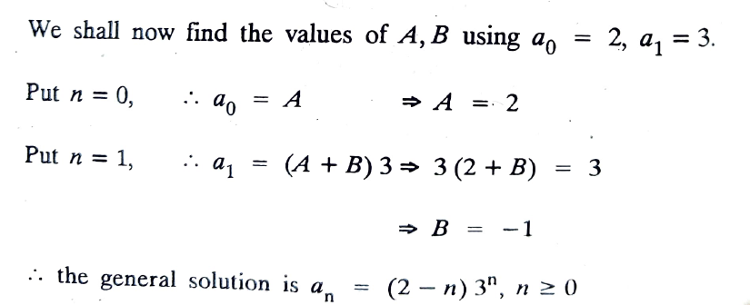
Problems – Characteristic Root Method

Slide 21
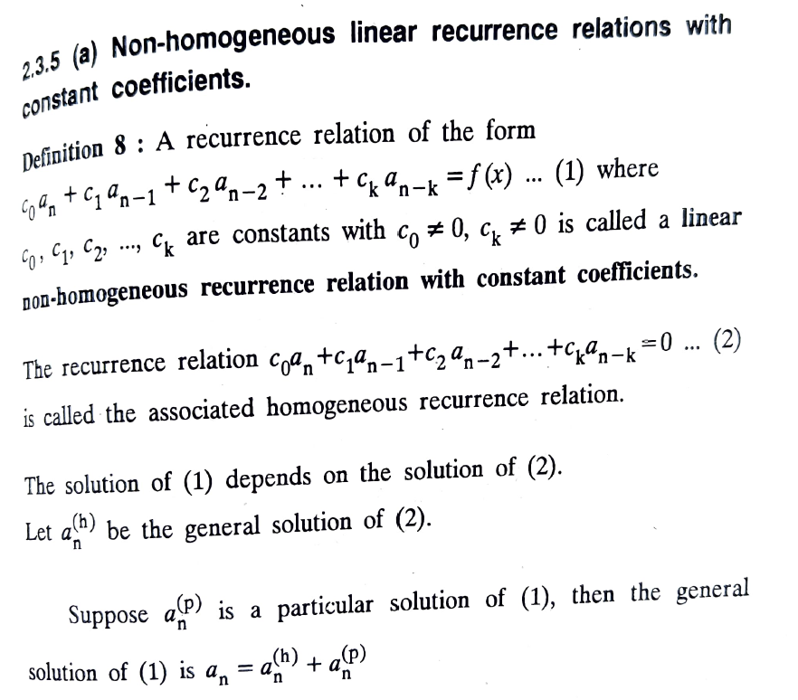
Problems – Characteristic Root Method

Slide 22
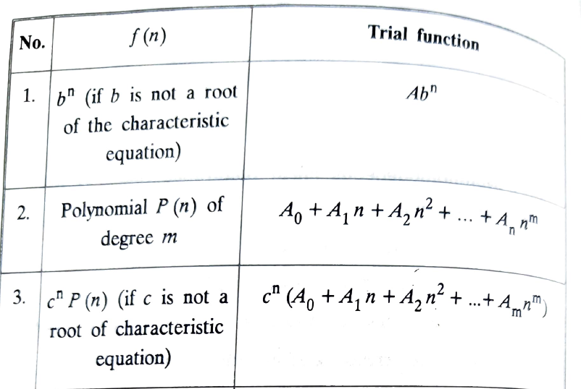
Non homogeneous recurrence relation

Slide 23

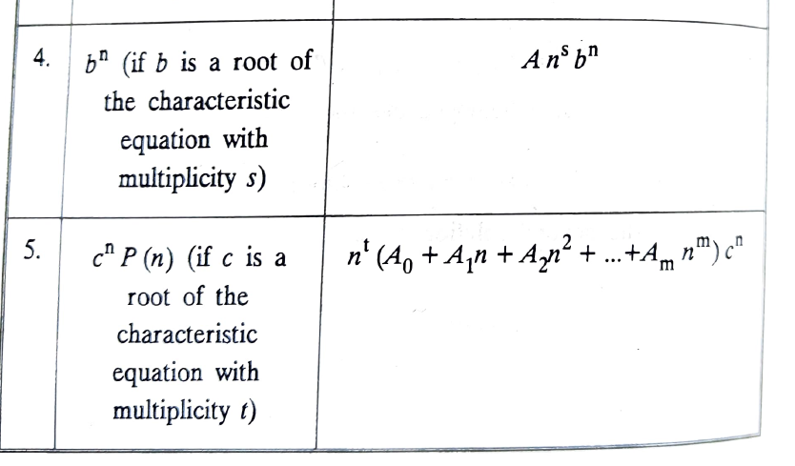
Non homogeneous recurrence relation

Slide 24
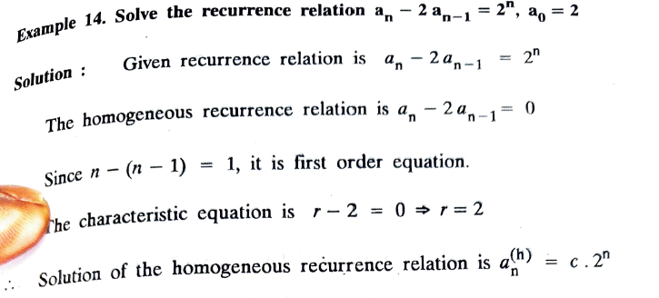
Non homogeneous recurrence relation

Slide 25
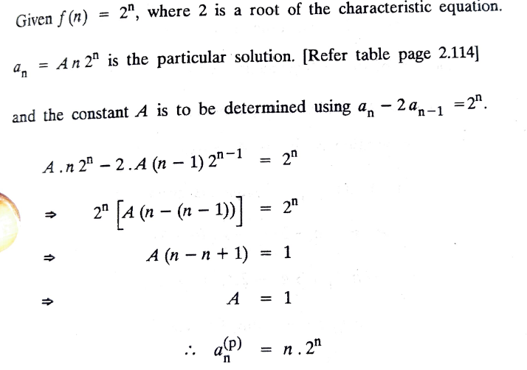
Non homogeneous recurrence relation

Slide 26
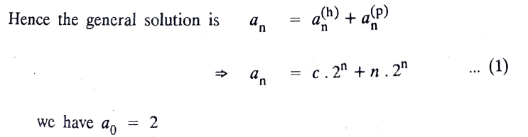
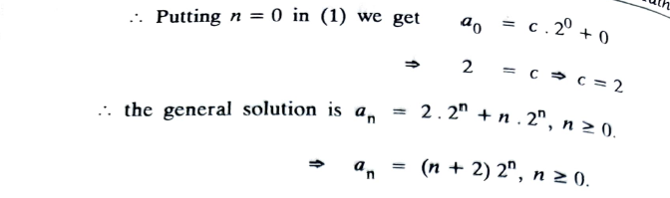
Non homogeneous recurrence relation

Slide 27
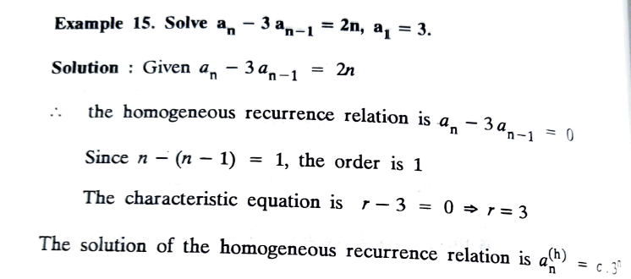
Non homogeneous recurrence relation

Slide 28
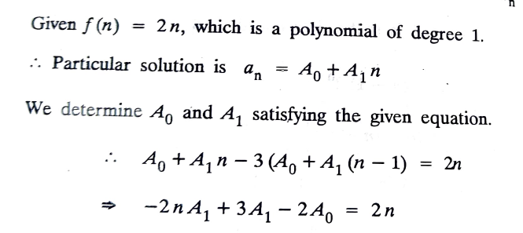
Non homogeneous recurrence relation

Slide 29
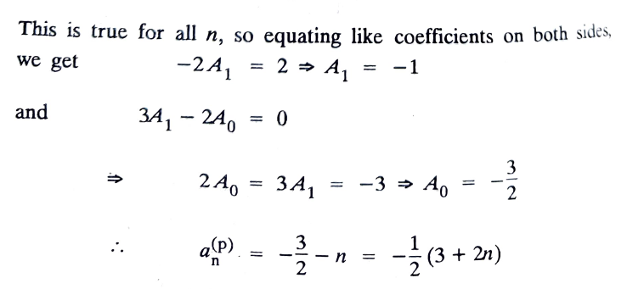
Non homogeneous recurrence relation

Slide 30
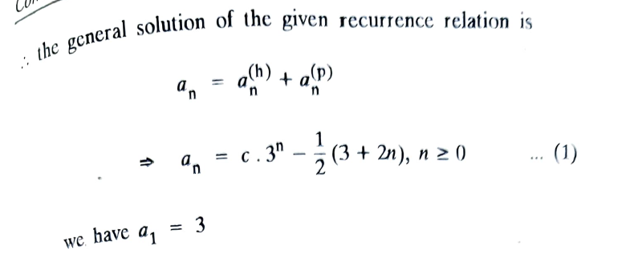
Non homogeneous recurrence relation

Slide 31
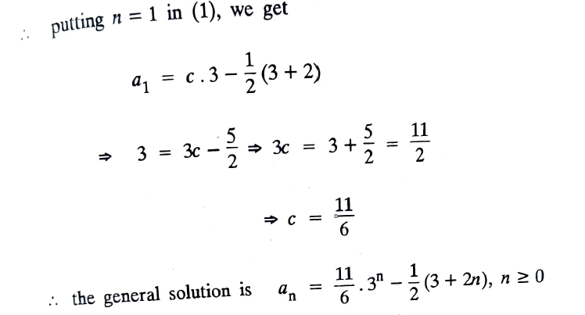
Non homogeneous recurrence relation

